Slide 1
Yun://Code
EE599 Project: A Coding Challenge Website
Lei Ding
GitHub: https://github.com/lding-code/EE599_Project

Slide 2
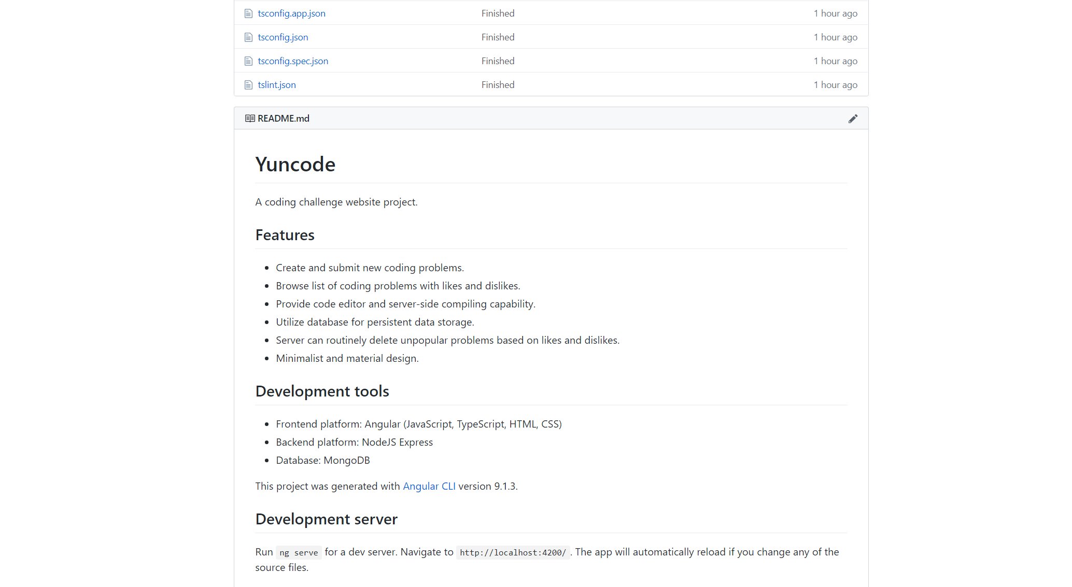
GitHub: https://github.com/lding-code/EE599_Project

Slide 3
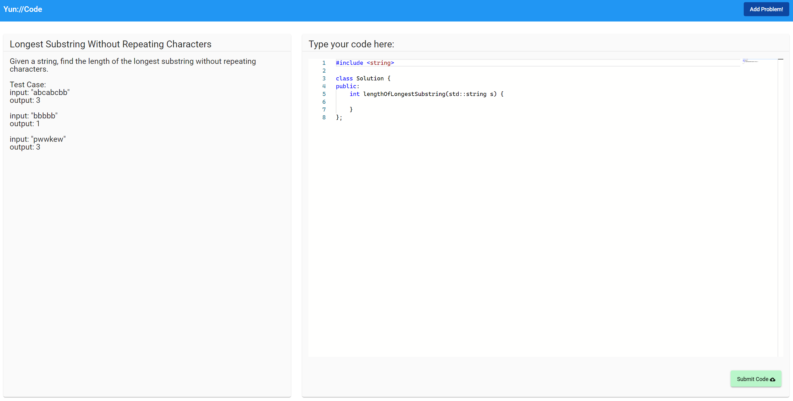



Visible Page
mongoDB database server
I/O Event
Active Render
Feed Data
Query
HTTP
Request
Angular server
HTTP
Response
Node.js + express server
FRONTEND
BACKEND

Slide 4



Visible Page
Routing module
“/”
“/probsolve/”
“/probadd/”
Material UI
ngx-monoco-editor
Active Routing
Subscription
Components:
Problem List
Problem Add
Problem Solve
Subscribe
response
give
ask
Service.method()
_id
Title
Desc
Tester
JSON
Service
HTTP Request
HTTP Response
express

Slide 5

Route: Problem Solve
Get Problem
Run Code
Submit
child_process
Route: Problem Add
Test
Add
Problem
Route: Problem List
Get Problem List
Set Likes
_id
Title
Desc
Tester
JSON
App
Routine
Check
Server
mongoose
express

